Slide 1



Introduction to Digital Evidence and Investigations
Explore the crucial role of digital evidence in modern criminal investigations. Understand how law enforcement and digital forensics experts leverage technology to uncover critical information and solve complex cases.

Slide 2



The Importance of Digital Evidence
Vital to Modern Investigations
Admissible in Legal Proceedings
Expanding Digital Footprint
Digital evidence has become an indispensable component of criminal and civil investigations, providing critical insights and data that can make or break a case.
Courts of law now widely accept properly collected and analyzed digital evidence, giving it the same weight as traditional physical evidence.
As our lives become increasingly digitized, the digital evidence trail left behind provides a wealth of information for investigators to leverage.

Slide 3




Types of Digital Evidence
Devices
Network Data
Digital Files
Database Records
Digital evidence can be found on a wide range of devices, including computers, smartphones, tablets, and even IoT (Internet of Things) devices like smart home systems.
Network traffic, logs, and metadata can provide valuable insights into online activities, communications, and connections during an investigation.
Digital documents, emails, photos, videos, and other files can contain crucial evidence that can be analyzed and used in investigations.
Information stored in databases, such as customer records, transaction logs, and user activity data, can be leveraged as digital evidence.

Slide 4




Collecting and Preserving Digital Evidence
Identify Data Sources
Determine the types of digital devices, networks, and systems involved in the case, such as computers, smartphones, cloud storage, and social media.
Secure the Scene
Ensure the integrity of the digital evidence by isolating, powering off, and preventing further access to the devices and systems.
Forensic Imaging
Create a bit-by-bit copy of the digital media using specialized forensic tools to preserve the original evidence in its original state.
Chain of Custody
Carefully document the collection, handling, and storage of the digital evidence to maintain its admissibility in legal proceedings.

Slide 5
Analyzing Digital Evidence
Identification
1
Locating and collecting relevant digital data
Preservation
2
Ensuring the integrity of digital evidence
Extraction
3
Retrieving data from various digital sources
Examination
4
In-depth analysis of the collected evidence
Analyzing digital evidence is a methodical process that involves identifying, preserving, extracting, and closely examining digital data to uncover valuable information. Each step in this process is crucial, as improper handling can compromise the integrity and admissibility of the evidence in legal proceedings.

Slide 6
Forensic Tools and Techniques
Digital Forensic Tools
Forensic Analysis
Chain of Custody
Emerging Technologies
Careful examination and interpretation of digital artifacts is crucial. Forensic analysts scrutinize file metadata, system logs, internet histories, and other data to uncover patterns and reconstruct events.
Maintaining a detailed chain of custody is essential to ensure the integrity of digital evidence. Strict protocols govern the handling, storage, and documentation of seized devices and data throughout the investigation.
Investigators leverage a wide array of specialized software tools to extract, analyze, and preserve digital evidence. These include disk imaging utilities, file recovery tools, password crackers, and network traffic sniffers.
New advancements in areas like machine learning and cloud forensics are revolutionizing digital investigations. Investigators must stay abreast of these evolving tools and techniques to stay ahead of sophisticated cybercriminals.

Slide 7
Legal Considerations in Digital Investigations
1
Chain of Custody
2
Privacy and Consent
Maintaining a strict chain of custody is crucial to ensure the admissibility of digital evidence in court. Detailed documentation of every step in the collection and handling process is required.
Investigators must navigate complex privacy laws and obtain proper consent when accessing digital devices and data during an investigation.
3
Expert Testimony
4
Applicable Laws
Qualified digital forensic experts may be required to provide testimony in court to authenticate and explain the significance of the digital evidence.
Investigators must be well-versed in the relevant laws and regulations, such as the Fourth Amendment, the Stored Communications Act, and any state-specific digital evidence statutes.

Slide 8

Case Studies and Best Practices
Explore real-world examples of successful digital investigations, showcasing how law enforcement and cybersecurity experts have leveraged digital evidence to crack complex cases.
Learn about industry-leading best practices for preserving chain of custody, conducting thorough analyses, and presenting findings in a court of law.

Slide 9
Challenges and Limitations in Digital Investigations
Technical Complexity
Data Volume and Diversity
Rapidly evolving technology poses challenges for investigators to stay up-to-date with the latest tools and techniques for digital forensics.
The vast amount and variety of digital data, from smartphones to cloud storage, require specialized expertise and resources to properly analyze.
Jurisdictional Barriers
Privacy and Civil Liberties
Digital crimes can cross international borders, complicating legal jurisdiction and cooperation between law enforcement agencies worldwide.
Balancing the need for digital evidence with individual privacy rights and civil liberties is an ongoing ethical and legal challenge.

Slide 10
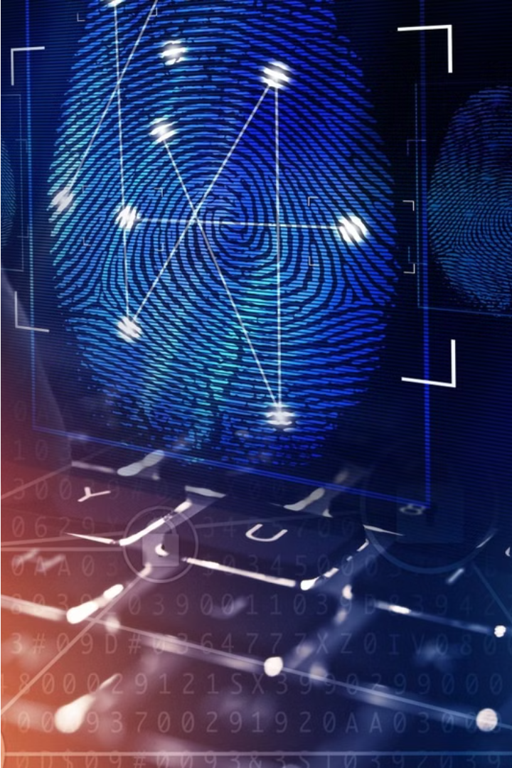
Conclusion and Future Trends
As digital evidence and investigations continue to evolve, new challenges and opportunities will emerge. Advances in technology, changes in legal frameworks, and emerging threats will shape the future of this critical field.

